Slide 1

Motivations Extension

Slide 2

MOTIVATION
Language
Notation
Deliverables
Who are you?
What’s wrong?
How do we fix it?
Notes:
This is the first time we are able to look at the weaknesses in the current solution!!!

Slide 3
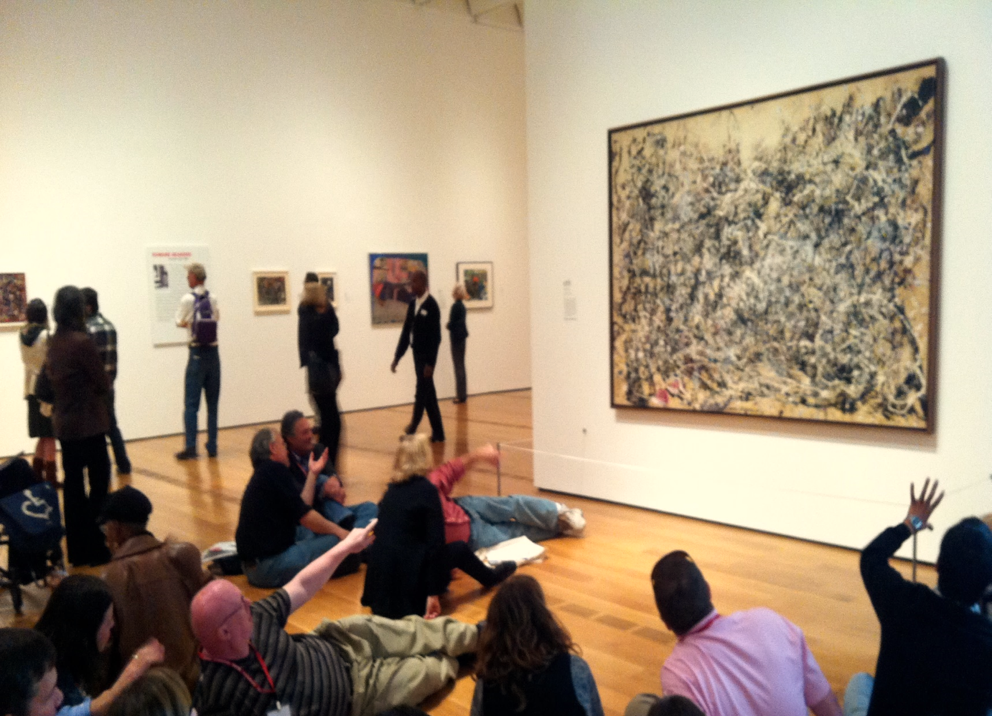
What defines your business? What do you care about?
What’s the good, the bad, and the ugly?
What elements need to change?
How should we change them?
FORM
AUDIENCE
MESSAGE

Slide 4
Application Viewpoints
Motivation Viewpoints
Application Behaviour
Application Co-operation
Application Structure
Stakeholder
Goal Realization
Goal Contribution
Principles
Motivation
Business Viewpoints
Layered Viewpoints
Organization
Actor Co-operation
Business Function
Business Process
Business Process Co-operation
Product Viewpoint
Application Usage
Information Structure
Infrastructure Usage
Implementation & Deployment
Layered
Requirements Realization
Notes:
Now?
Audience?

Slide 5

WHAT PROPELS US?
Notes:
First question Archimate drives us to ask is:

Slide 6
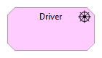
 | EXISTING PRODUCTS | NEW PRODUCTS
EXISTING MARKETS | Market Penetration Existing resources Existing capabilities Company growth with market growth Outmatching competitor capacity Preparing for market saturation | Product Development Variation, development, and flexibility Improve and rely on customer relationships
NEW MARKETS | Market Development New geographies, new sectors Emphasis on product competencies New competitors, new supply chains Preparing for product saturation | Diversification High risk – “the suicide cell” Stretches competency and capability Footholds in new markets Chance of high return
Notes:
Can be TRICKY to ILUCIDATE – but don’t fear: refer to WELL-ESTABLISHED lists like this one from ANSOFF

Slide 7
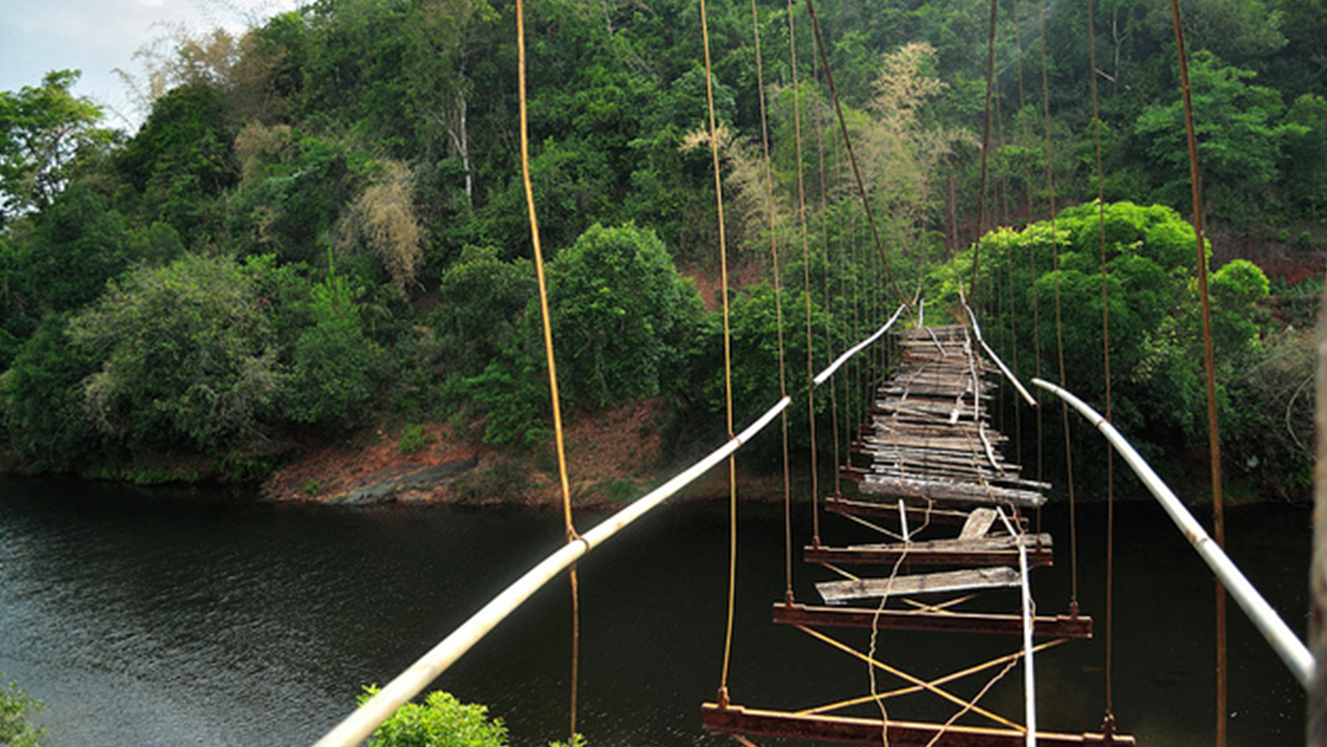
STRENGTHS WEAKNESSES OPPORTUNITIES THREATS
Notes:
ASSESSMENT of the situation
ARCHIMATE doesn’t have PERFORMANCE INDICATORS! ☹

Slide 8
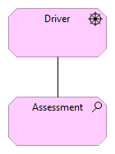





Technology
Content
Governance
Continuity
Platforms
Compliance
Customer
Personalisation
Targeting
Roadmaps
Strategy
Accessibility
Segmentation
Search Engine Optimization
User Experience
Self-Service
Ownership
Sponsorship
Compatibility
Single View
Usage Analytics
Capacity
Resourcing
Agility
Quality Assurance
Single Sign On
Hosting
Requirements
Workflow
Change Control
Moderation
Best Practices
Translations
Consistent Experience
Goal Metrics
Action Planning
Vulnerability Scanning
Forensic Investigation
Performance
Support
Penetration Testing
Notes:
PREFER STRUCTURE, RE-USE!
If it’s “DIGITAL RELEVANCE” maybe we could use THESE TOPICS to ASSESS
PROVOCATION – CRITICAL THINKING

Slide 9
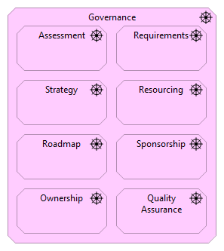
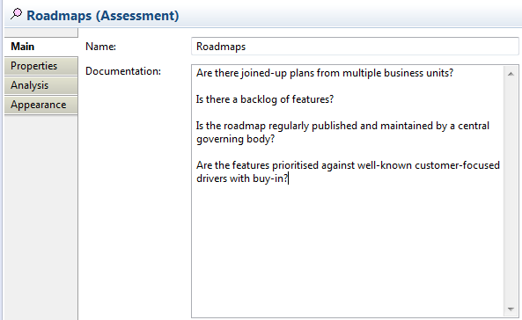
Notes:
GOVERNANCE DRIVER – shows other drivers that are PART OF
PROPERTIES in Archi give questions

Slide 10


Notes:
Again – you don’t need to reinvent the wheel – there’s plenty of maturity models relevant to your business!
Lean 6 Sigma
GARP for Records Management or Gartner’s Infrastructure & Operations

Slide 11

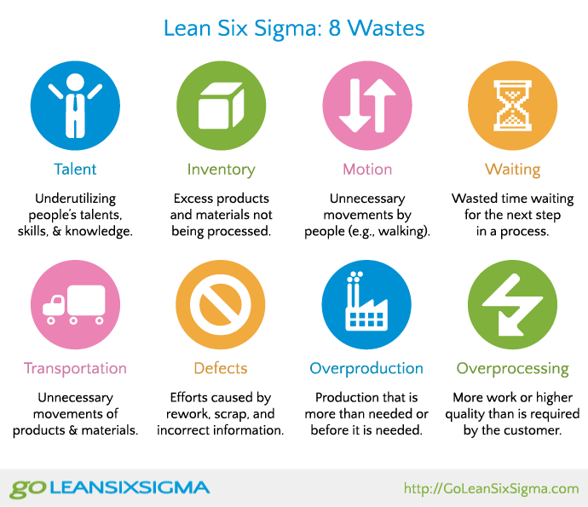
Notes:
If our driver is “LEAN-NESS”
These are the topical areas to ASSESS – so we could show these as

Slide 12

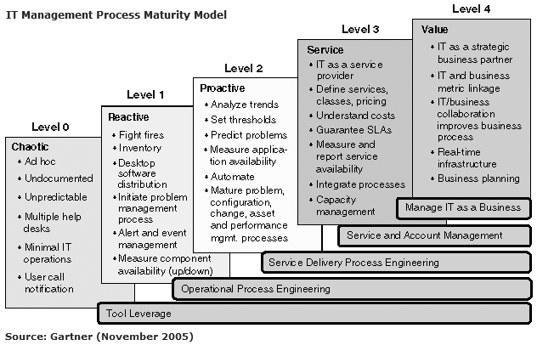
Notes:
If our driver is GOOD INFRASTRUCTURE & OPERATIONS, we can use something better – a MATURITY INDICATOR. We know WHAT to look out for and can agree a TARGET STATE.

Slide 13
Notes:
There is a two-way flow – an assessment should have a driver, and a driver should have assessments.
When it’s VISUALISED, Archimate can help you argue for clarity of BOTH

Slide 14
Create your first STAKEHOLDER viewpoint! Add DRIVERS and ASSESSMENTS for now

Slide 15
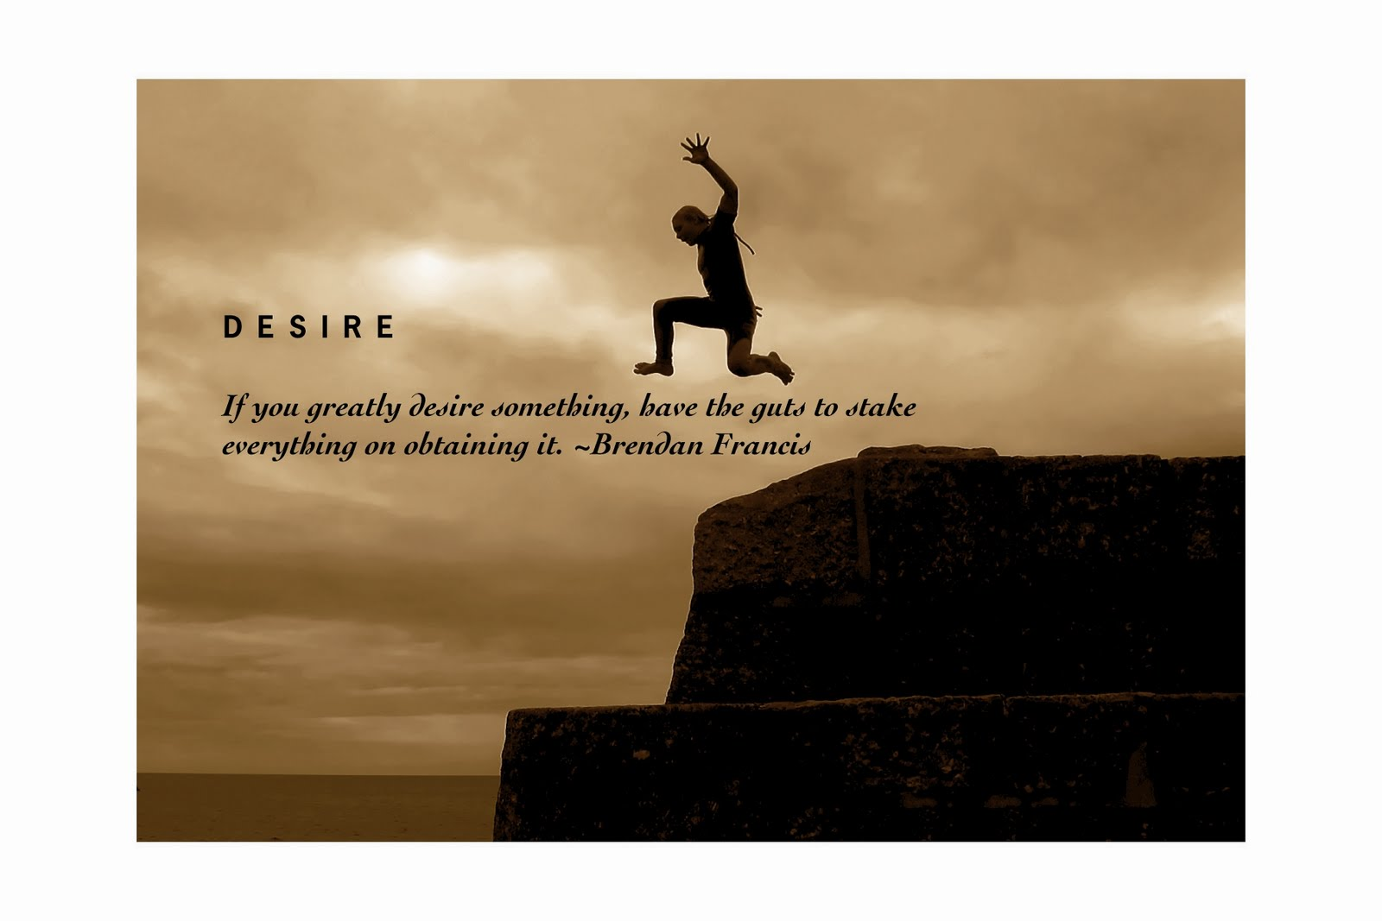
Notes:
DRIVERS need ACTION
“FAITH WITHOUT DEEDS IS DEAD”

Slide 16
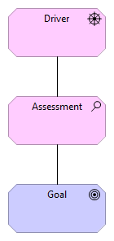

“A long time foodie, during the height of America’s cupcake craze, Brendan sought refuge in Europe, where he wrote and edited travel guides.
…lest you think he has a face for radio, the national fashion website Racked named him a “style icon,” and that’s without even knowing about his tattoo of the word “tattoo”
Notes:
And if you were wondering, this is Brendan Francis.
WELL – A Brendan Francis.

Slide 17
Bigger cupcakes
More facial hair
Greater sense of self-importance
Less fewer indecisive moments in coffee shops
More easier access
More extra satisfactions
Notes:
What might Brendan’s goals be?
QUALITATIVE words describing the END STATE
ARCHIMATE 3 has OUTCOMES
Archimate handout

Slide 18
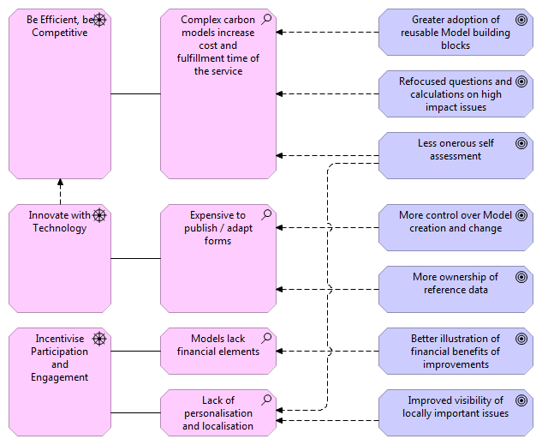
Notes:
Here’s a real example of a “Motivations viewpoint”
It’s scoped to product development goals
ARCHIMATE → OVERLAPS (goals + two assessments, influence), PRIORITISATION, COMPLETENESS (no goal without a driver)

Slide 19
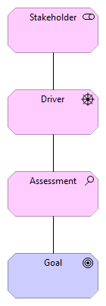
Regulators
Secondary customers
Primary customers
Quality controllers
Process owners
Subject matter experts
Process controllers
Notes:
BUT
Archimate sees Stakeholders with “Motivational involvement” as different to people who use or act within the business
Here we're interested in people ASSOCIATED with DRIVERS.
“Doing the right things // doing things right”
So who might drop off this “traditional” list?

Slide 20
Add GOALS and STAKEHOLDERS to your viewpoint

Slide 21
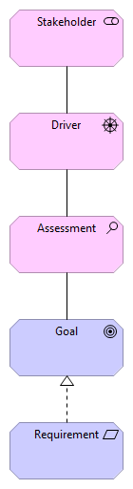
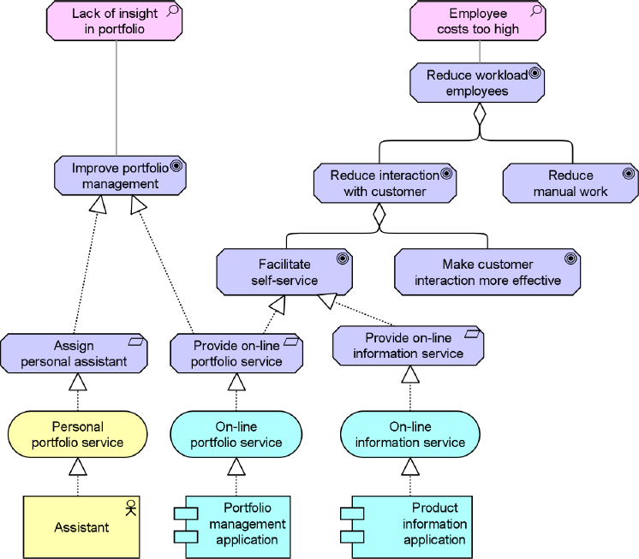
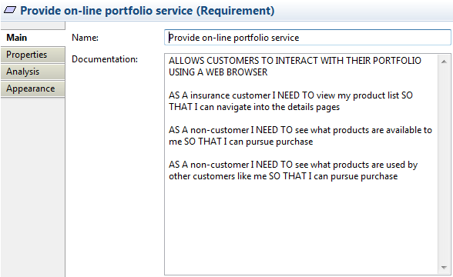
“A statement of need that must be realized by the design”
Notes:
MAKING THE DIFFERENCE - TALK THROUGH IT
LEADS TO: WHAT TO CHANGE
Who might the audience be for this using the BUSINESS LAYER?
APPLICATION LAYER?
USE & REALIZATION?
SPECIFICATION
backed up by
WHY
OPTIONS

Slide 22

Industry
Environmental
Strategic
Temporal
These factors result from specific industry characteristics.
These factors result from macro-environmental influences on an organization.
These factors result from the specific competitive strategy chosen by the organization.
These factors result from the organization's internal forces.
Specific barriers, challenges, directions, and influences will determine these CSFs.
The way in which the company chooses to position themselves, market themselves, whether they are high volume low cost or low volume high cost producers, etc.
Things like the business climate, the economy, competitors, and technological advancements are included in this category.
These are the things that the organization must do to remain competitive.
Rockart
Notes:
Here’s the types of CSF.

Slide 23
Draw a Goal Realization diagram Perfect the Archi skill of re-using, not adding, elements Associate Requirements with elements in other layers Present back

